Slide 1
Shared reading on
My Hero is You - how kids can fight COVID-19!
Learning and Teaching Resources for English Language (P4 - 6)
Developed by English Language Education Section
Curriculum Development Institute
Education Bureau

Slide 2
Learning Objectives:
To develop students’ understanding of how to cope with the COVID-19 pandemic
To nurture students’ positive values and attitudes in the face of adversities and to show their love and care to their friends, families and community
To develop students’ reading skills and story writing skills

Slide 3
Pre-reading activities
Refer to Worksheet p.1
Work in pairs. Share with your partner about the following:
Do you have a hero/super hero in mind? Who is he/she?
What are their super powers?
The book is called “My Hero is You”. Who do you think is the hero in the book?

Slide 4
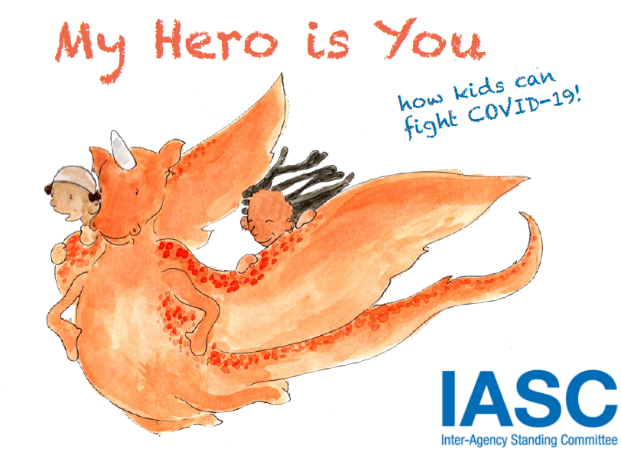
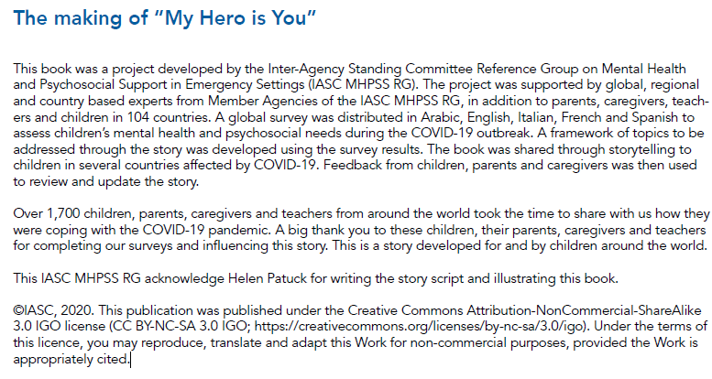
Background information:
(Play the YouTube video 00:00-00:53)
This is a story about a girl Sara’s adventure with Ario.
Ario is a fantasy creature which can fly.
Sara and Ario met some new friends in their adventure. One of them is Salem, who is sitting on Ario’s wing.
This book was a project developed by IASC.
Listen to your teacher’s reading of the story. You may also click the link to listen to the story:
https://www.youtube.com/watch?v=V29jbjPlEUA

Slide 5
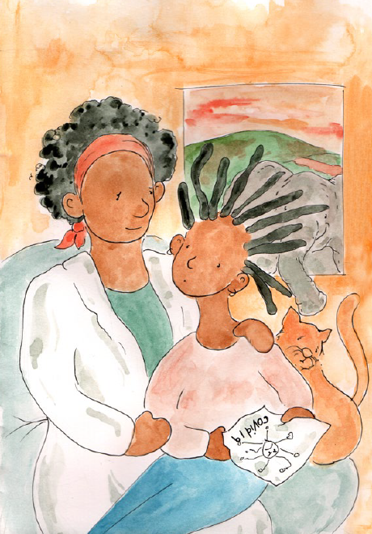
While-reading activities:
First reading
1. Background of the story:
(Play the YouTube video 00:54-02:13)
Sara’s__________ is a scientist, but she cannot find a _________ for the coronavirus.
Sara was upset because the virus was affecting her life.
mum
cure
She asked Sara to take good care of herself and stay safe, so that she could focus on her work.
Sara decided to tell all the children in the world how to _________ themselves so that they could protect everyone else.
protect
Refer to Worksheet p.2
Let’s read on to find out the following:
Who are in the story?
What problems did they face because of COVID-19 and how did they cope with the problems?
Sara and her mum

Slide 6
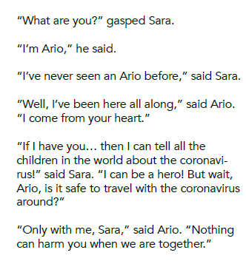
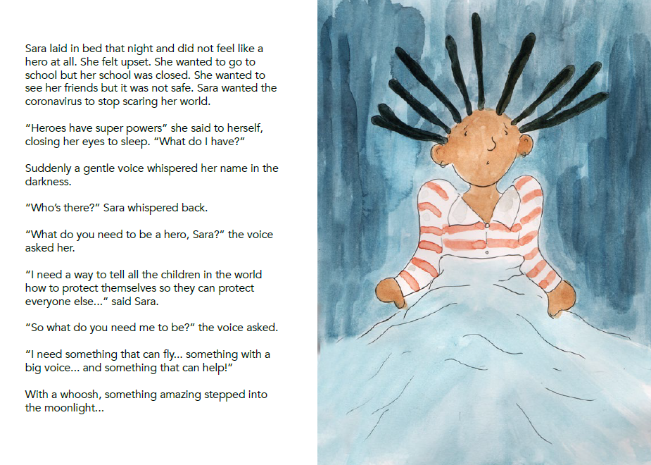
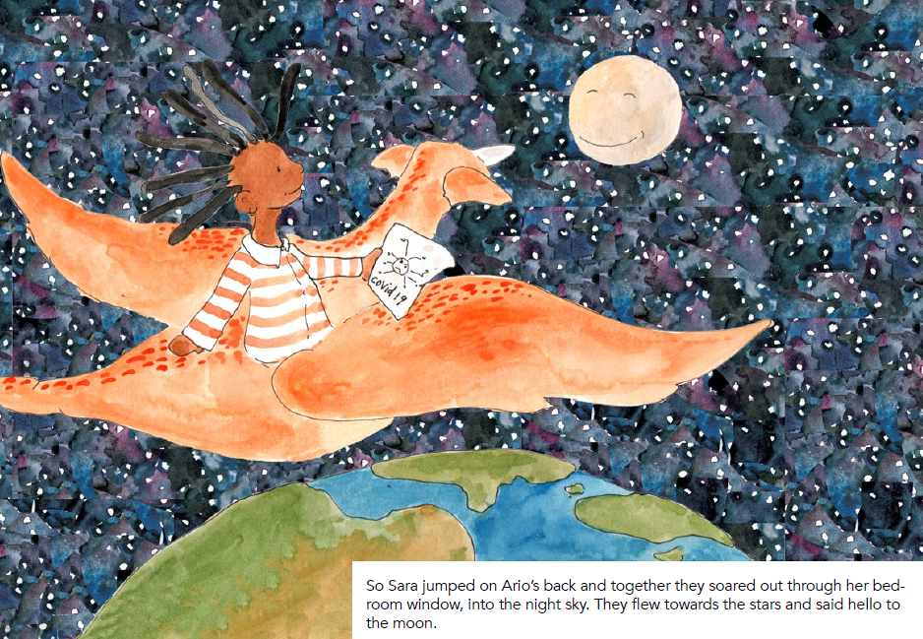
2. Sara met Ario.
(Play the YouTube video 02:14-4:56)
Sara met Ario. Ario is a creature that comes from Sara’s heart and has always been with Sara. He can fly and has a big voice. He brought Sara to different places in the world and told children in the world how to protect themselves. Sara jumped on Ario’s back and they travelled together.

Slide 7
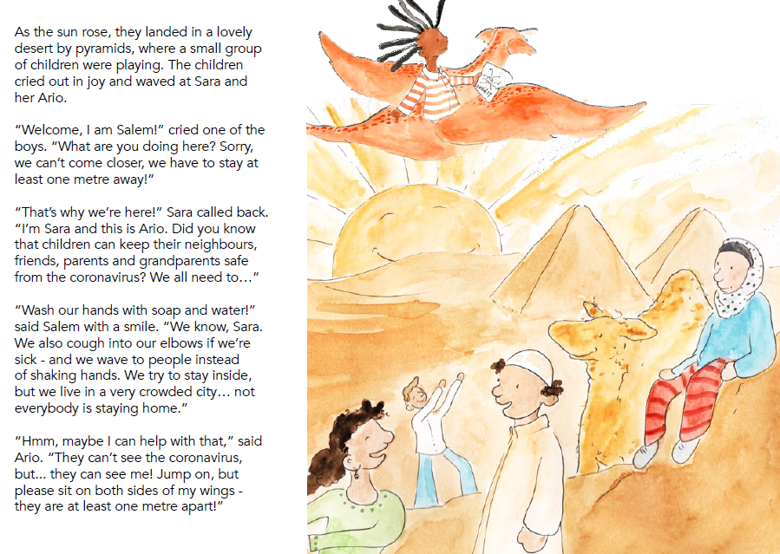
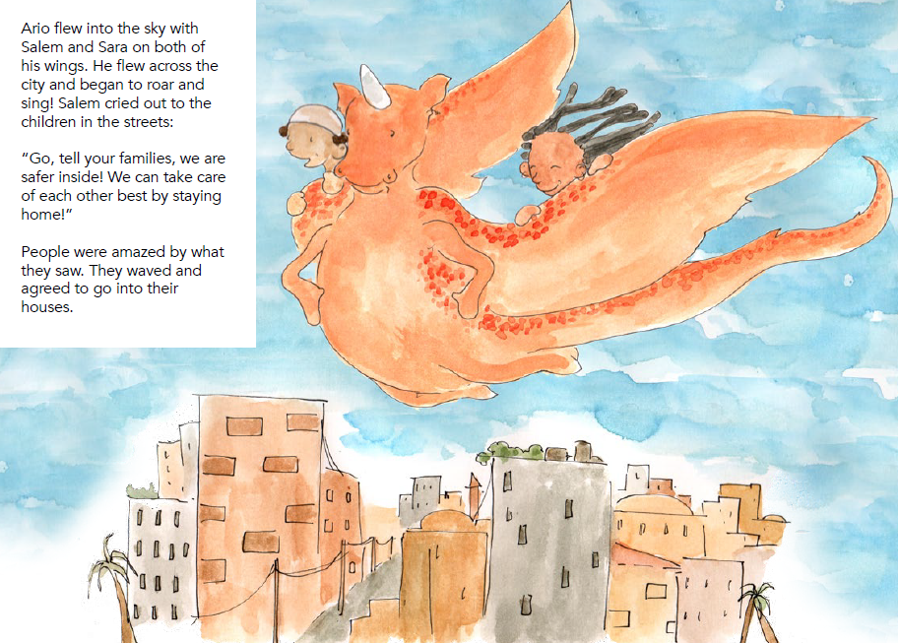
3. Sara and Ario met Salem.
(Play the YouTube video 4:57.-7:13)
Problems
Ways to cope with the problems
COVID-19 was affecting his life.
The city he lived in was __________ but not everyone stayed at home.
In order to protect himself, he stayed at least _______ metre away from people, washed his hands with _________ and water. He also coughed into his elbows if needed and ________ to people instead of shaking hands.
He flew across the city with Ario and Sara to tell everyone to stay _____________.
one
soap
waved
crowded
home/inside
Ario flew into the sky with Salem and Sara on both of his wings.
Salem is a boy who lives in a city near a desert.

Slide 8
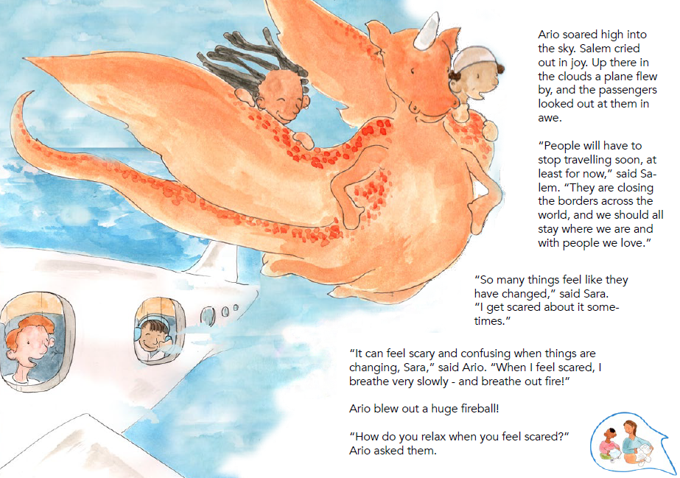
4. What can I do when I feel scared?
(Play the YouTube video 7:14-9:43)
Way to cope with the
problem
Problem
Salem missed the people he loved a lot, including his grandparents
He chatted with grandparents on the ___________ and shared what he did every day.
phone
“People will have to stop travelling soon. They are closing the borders across the world,” said Salem.
They saw a plane with passengers inside.
Way to cope with the
problem
Problem
When he felt scared, he breathed very ___________ to calm down.
Ario felt scared sometimes.
slowly
Salem’s grandfather

Slide 9
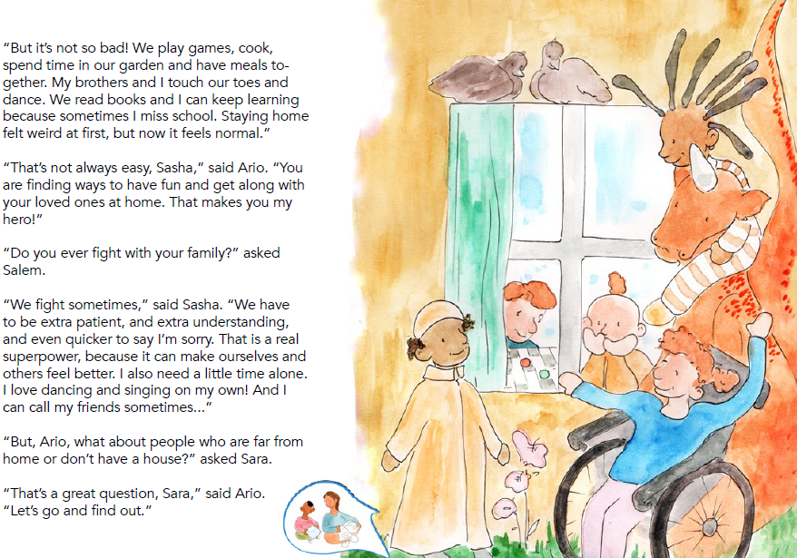
5. What would happen if your family member had the coronavirus?
(Play the YouTube video 9:44-12:35)
Problems
Ways to cope with the problems
dad/father
Sasha’s ____________ was sick and she was worried that she might spread the virus.
She sometimes argued with her family because they stayed together all the time at home.
1. She did the following in order not to spread the virus:
keeping a distance from people
using ___________ to show her care instead of hugging people
staying home
2. She had to be extra ____________ and extra understanding, and quick to say “sorry”.
words
patient
Ario introduced Sasha to the children. Sasha’s dad had the coronavirus. Ario said Sasha had superpowers.
Sasha played games, cooked, spent time in the garden with her brother and had meals together .

Slide 10
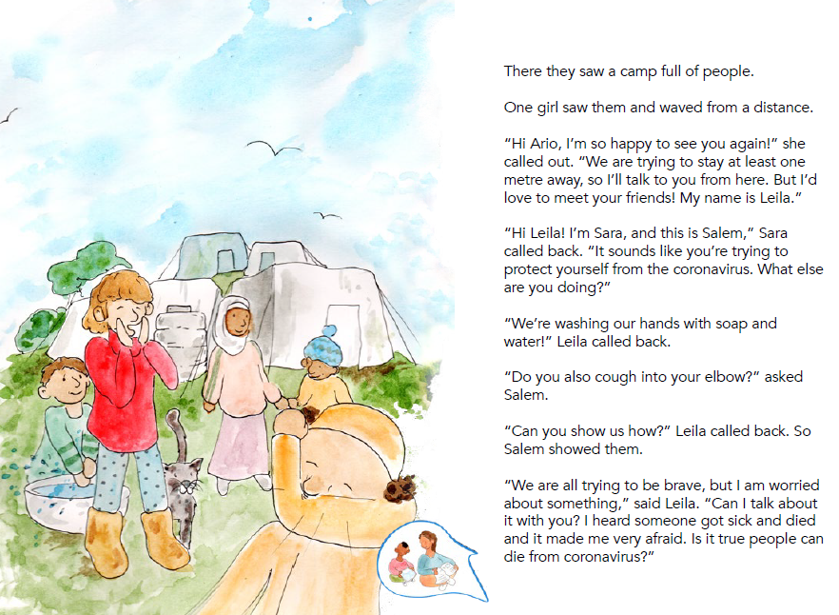
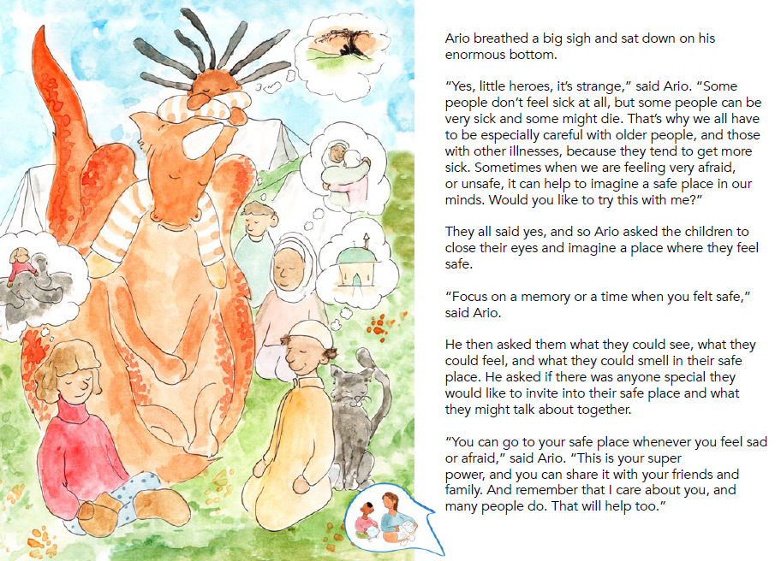
6. Is it true that people can die from coronavirus?
(Play the YouTube video 12:36-16:30)
Problem
Way to cope with the problem
Leila was afraid of the virus because people might die from it.
She followed Ario’s advice by imagining a ___________ place in her mind. This helped her relax and keep her calm.
safe
And so they said goodbye to Sasha and set off once more. The air grew warmer as they landed on an island surrounded by the sea.
They landed on an island and saw a camp full of people. They met Leila.
Leila was worried and asked Ario. “Is it true people can die from coronavirus?”

Slide 11
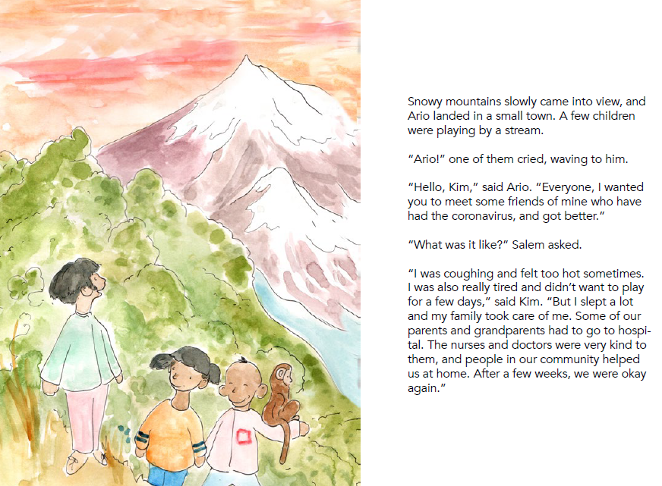
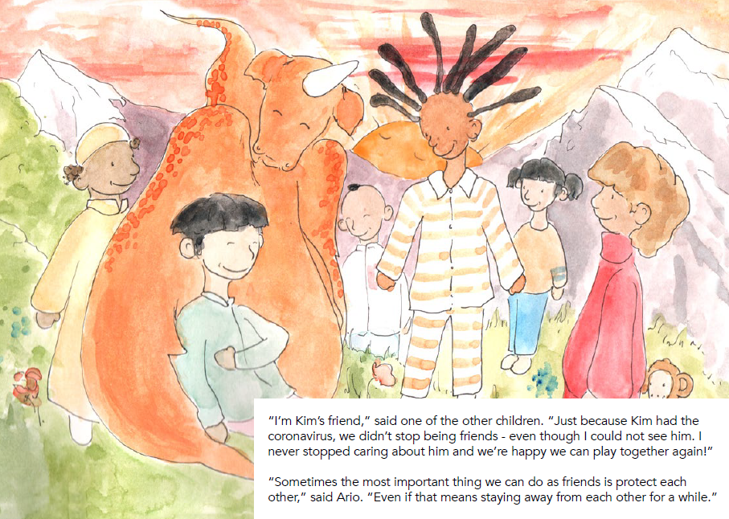
7. Last journey: What does it feel like to have the coronavirus?
(Play the YouTube video 16:31-19:02)
Leila travelled with Ario and her new friends.
Problem
Way to cope with the problem
Kim had the virus himself and had recovered from it.
He kept a distance from his friends who cared about him. He believed that the most important thing friends could do was to ____________ each other. .
protect
Leila said, “We can all care for each other.”
“That’s right, Leila,” said Ario. “We can care for each other, wherever we are. Would you like to come with us on our last journey?”
Leila decided to travel with Ario and her new friends. Sara was glad Leila joined them because she know that sometimes we need to support each other. The flew quietly, without words, but Leila knew her new friends cared a lot about her.
“Just because Kim had the coronavirus, we didn’t stop being friends,” said one of Kim’s friend. “Even though I could not see him.”
A few children were playing by a stream. They met Kim, a boy who once had the coronavirus, and got better.

Slide 12
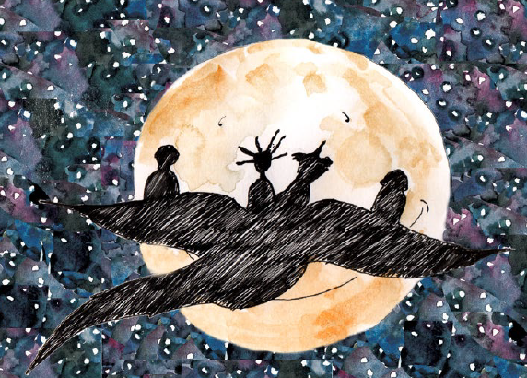
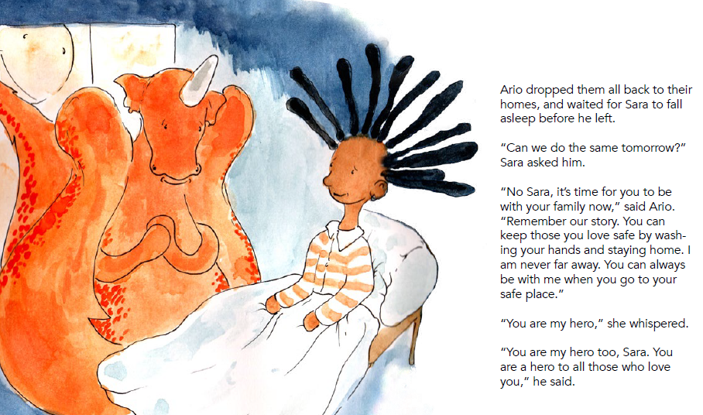
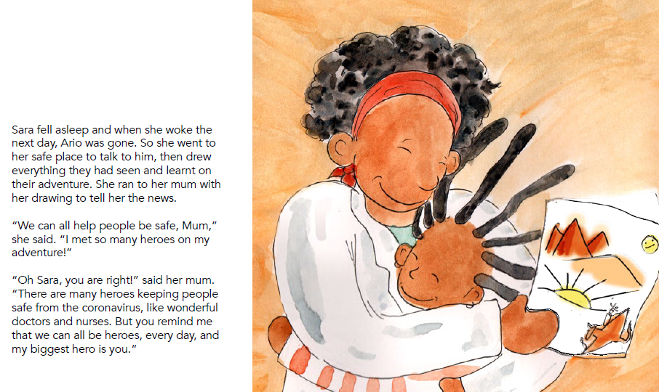
8. Sara said goodbye to her friends
(Play the YouTube video 19:03-21:57)
Sara felt sad that they might not see each other for a while. But she felt better when she remembered what Kim’s friend had said. Just because you can’t see people, it doesn’t mean you stop loving them.
“You are my hero,” Sara told Ario.
“You are my hero too, Sara. You are a hero to all those who love you,” he said.
“We can do these things for each other,” said Leila.
“And one day, we will all be able to play again and go back to school like we used to,” said Salem.
It was time to go home, and time for Sara to say goodbye to her new friends. They promised each other that they would never forget their adventure together.
Sara felt sad that they might not see each other for a while. But she felt better when she remembered what Kim’s friend had said. Just because you can’t see people, it doesn’t mean you stop loving them.
Ario dropped all the children back to their homes, and waited for Sara to fall asleep before he left.

Slide 13
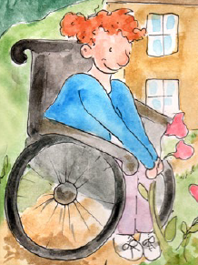
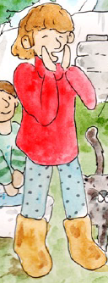
Second reading
1. Read the story again and understand more about the characters
Refer to Worksheet p.5
Read the story again and understand more about the four characters, Salem, Sasha, Leila and Kim by thinking about the following questions:
Where did they live?
What were their super powers?
Characters
Salem
Sasha
Leila
Kim

Slide 14
Questions | Character: Salem
Where did Salem live?
What were his super powers?
desert
He lived near a _______________ next to pyramids. He probably lived in a Middle East country called Egypt.
a pyramid
He knew how to protect himself and others from catching the virus.
He was eager to remind the people in the city to take care of each other best by staying _________________. He cared about his ________________ by talking with them on the phone every day.
a desert
home/inside
a camel
grandparents
Use two adjectives to describe Salem.
e.g. smart, positive, caring
As the sun rose, they landed in a lovely
desert by pyramids, where a small group of children were playing. The children cried out in joy and waved at Sara and her Ario.

Slide 15
Questions | Character: Sasha
Where did Sasha live?
What were her super powers?
She lived in a small ____________. It was a place in the countryside, where there were green trees, beautiful flowers, and birds flying in the sky.
village
She knew a lot about social distancing.
Her father was sick and she had to stay home to __________ sharing the virus with others.
Although she was on wheelchair and unable to _________ , she stayed positive and enjoyed her life with her family even though they had to keep a distance from others.
She had great patience and was willing to apologise when she made a mistake.
avoid
walk
Use two adjectives to describe Sasha.
e.g. optimistic, patient, considerate
And so they soared down to earth and landed by a small village. A girl was outside her house picking flowers. When she saw Ario and the children sitting on his wings, she laughed.

Slide 16
Questions | Character: Leila
Where did Leila live?
What were her super powers?
She lived in a camp which provided a temporary shelter for the homeless people.
She knew how to keep herself safe from the virus.
She could cope with her _______________ by imagining a safe place in her _________.
She gave support to her friends and joined Sara and Ario in the journey to make people know more about COVID-19.
fears/worries
mind
Use two adjectives to describe Leila.
e.g. brave, helpful, hopeful, positive
They said goodbye to Sasha and set off once more. The air grew warmer as they landed on an island surrounded by the sea. There they saw a camp full of people. One girl saw them and waved from a distance.

Slide 17
Questions | Character: Kim
Where did Kim live?
What were his super powers?
snowy mountains
He lived in a small town, which was near a snowy ___________ and a ___________.
mountain
stream
He could stay positive although he once had the coronavirus.
He had some good friends. They cared about each other. They understood that staying away from each other for a while could ______________ each other.
a stream
protect
Snowy mountains slowly came into view, and
Ario landed in a small town. A few children
were playing by a stream.
“Ario!” one of them cried, waving to him.
“Hello, Kim,” said Ario. “Everyone, I wanted
you to meet some friends of mine who have
had the coronavirus, and got better.”
Use two adjectives to describe Kim.
e.g. positive, sociable, friendly, caring

Slide 18
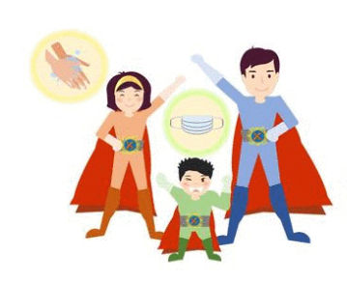
Refer to Worksheet p.7
4. The key message of this story is “heroes come in all shapes and sizes”. In short, anyone can be a hero, including ourselves. The super powers of the characters are in the boxes below. Explain the super powers by giving more details.
1) Know how to protect ourselves from COVID-19:
2) Show our love and care to our friends and relatives by:
stay at least one metre away
wash our hands with soap and water
cough into our elbows if we’re sick.
wave to people instead of shaking hands
calling them or sending them messages every day to show our love and care to them.
3) Sometimes, to protect our friends and family members, we have to
stay away from each other for a while
5) Be brave to share our worries and stay calm:
4） Be extra patient and understanding by:
getting along well with our family members at home, e.g. Do not quarrel with them and learn to say “I’m sorry.”
imagine a safe place in her mind when we feel sad or afraid.
remember that many people cared about us and stay strong.

Slide 19
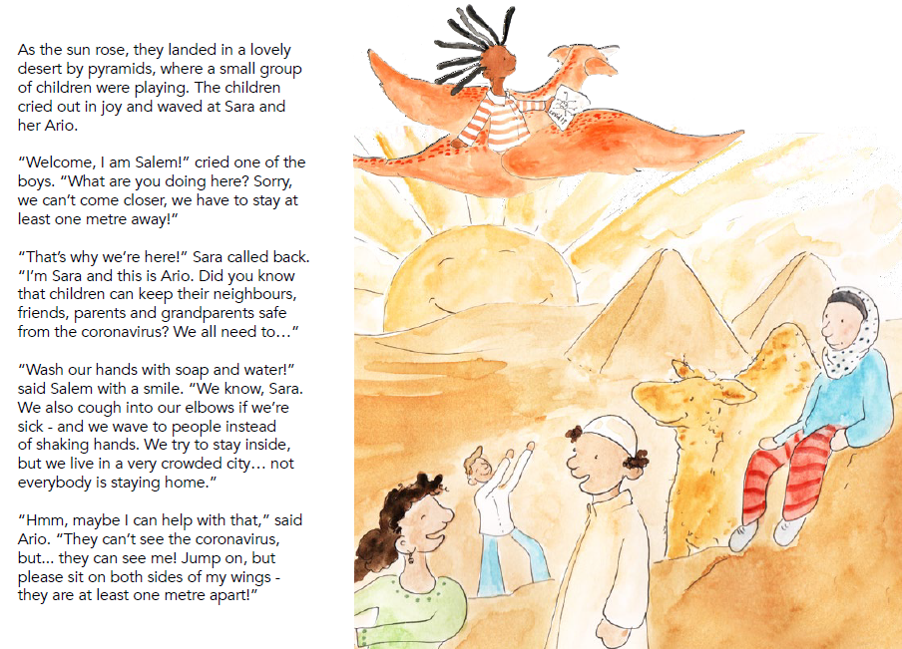
Re-read Part 3 of the story “Sara and Ario met Salem” and underline the features of a story.
Refer to Worksheet p.8
Features of a story
Grammar and Language used in a story
Setting: Where did the story take place?
The simple past tense to write about things that happened:
e.g. The children cried out in joy and waved at Sara and Ario.
The past continuous tense to show an ongoing past action which was happening at a specific moment:
e.g. As the sun rose, they landed in a lovely desert by pyramids, where a small group of children were playing.
Characters: Who did they meet?
3 ways to keep ourselves safe from the coronavirus
Use dialogues in stories and make use of the present tenses wherever appropriate:
e.g. “Welcome, I am Salem!” cried one of the boys. “What are you doing here?”
Plot: What did they say?/What happened?
Problem:
What problem did the character face?

Slide 20
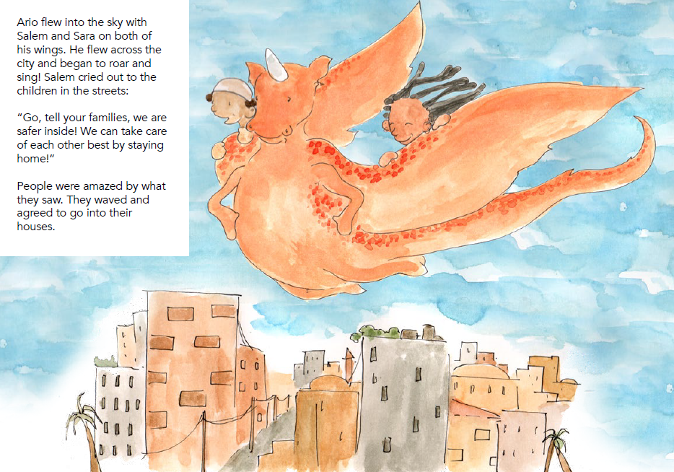
Solution: How did they solve the problem?
The imperatives to give advice:
e.g. “Go, tell your families, we are safer inside!”
Use adjectives and action verbs to describe feelings:
e.g. The children cried out in joy and waved at Sara and her Ario.
e.g. People were amazed by what they saw. The waved and agreed to go into their houses.
Ways to keep ourselves safe from the coronavirus:
Wash our hands with soap and water
Cough into our elbow
Wave to people instead of shaking hands
Take care of each other by staying home

Slide 21

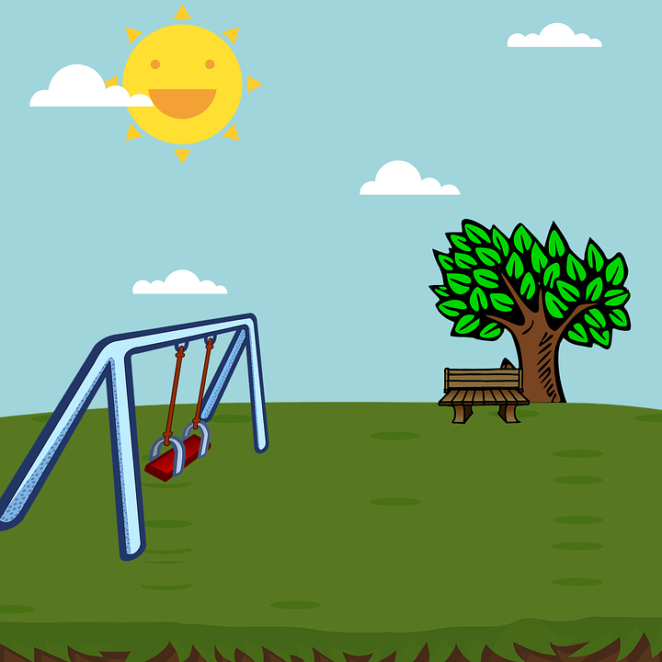
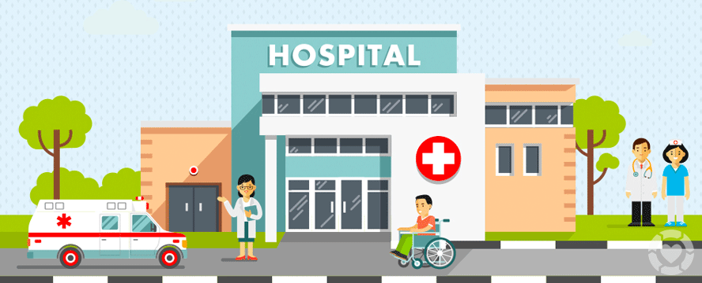
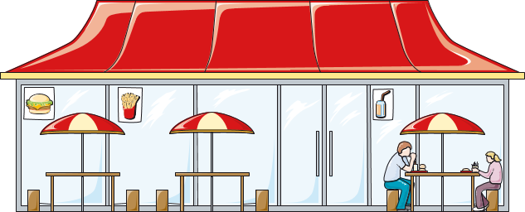
Writing task:
Sara and Ario visited Hong Kong one night. You met them and visited a place together. Write what you saw and did with them.
Refer to Worksheet p.9
Write about one of the following scenes and include the following:
problems people faced during the COVID-19 pandemic, and
share your advice / positive message with the people you met and help them fight COVID-19.
at your school
at a park
in a hospital
in a restaurant
Acknowledgement: the clip arts are taken from Creative Commons.

Slide 22
Acknowledgements
Information and images/pictures in this set of slides are taken from the following book published by the Inter-Agency Standing Committee (IASC):
My Hero is You - how kids can fight COVID-19!
https://interagencystandingcommittee.org/iasc-reference-group-mental- health-and-psychosocial-support-emergency-settings/my-hero-you
The video is presented by Dr. Linda Thomson to help students understand the book and can be accessed via the following link:
https://www.youtube.com/watch?v=V29jbjPlEUA

